Slide 1
HTML
Hypertext Markup Language
Introduction

Slide 2
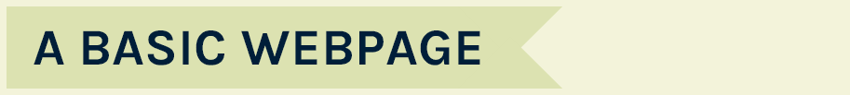
A webpage is mainly built using 3 web languages
HTML Hypertext markup language – coding the page
CSS Cascading styles sheets – formatting the code
JS Java script – making the page interactive

Slide 3
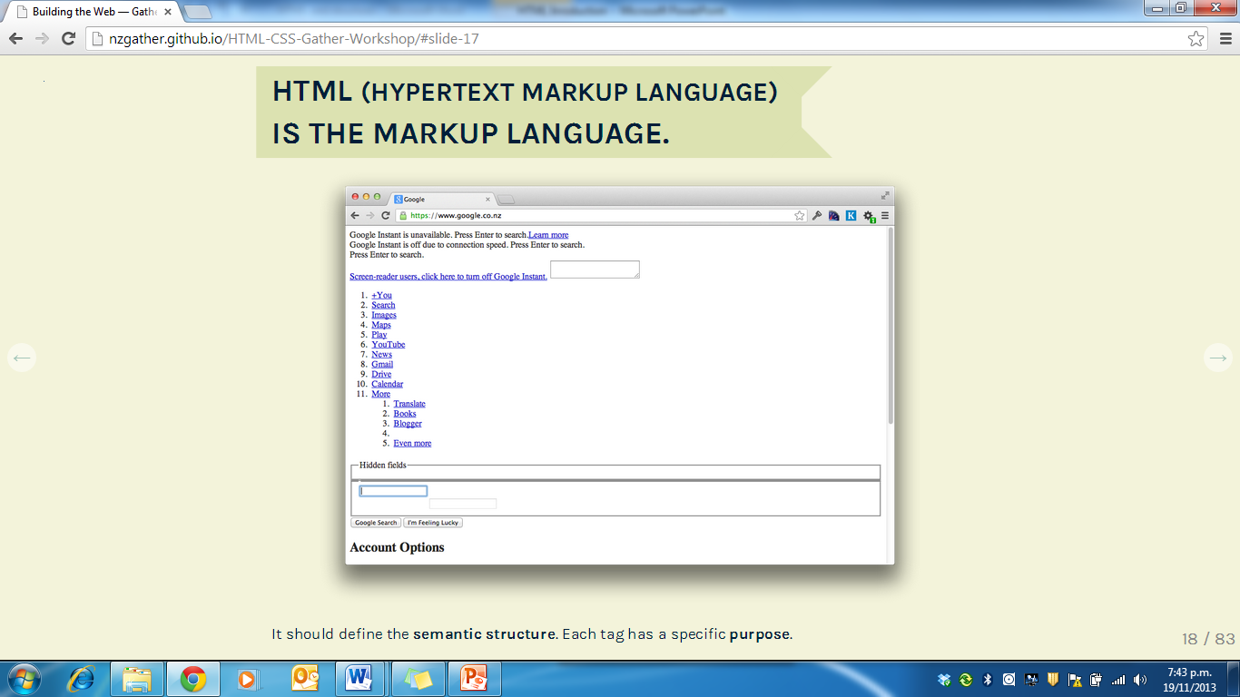
Notes:
This is what a wepage would look like without the CSS design features added. This is the google site.

Slide 4
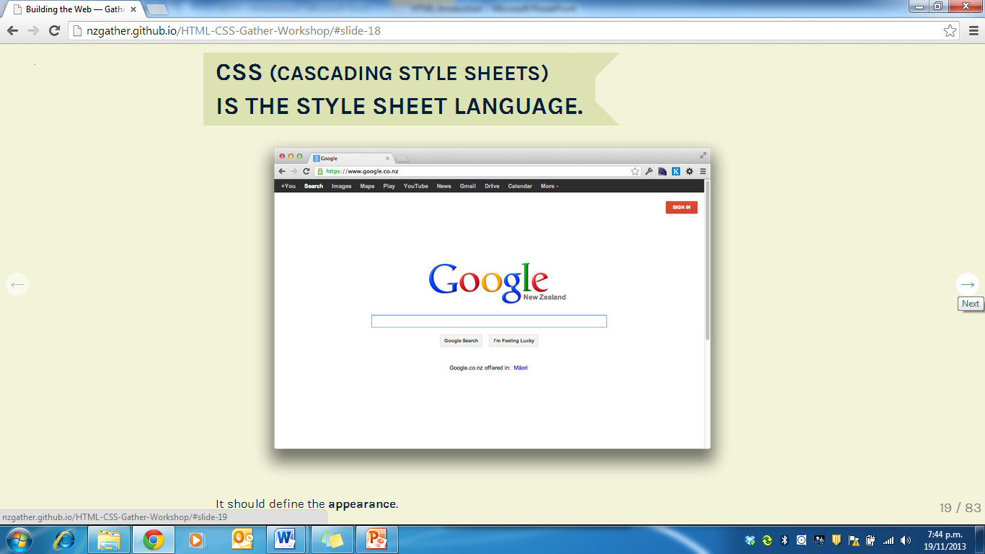

Slide 5
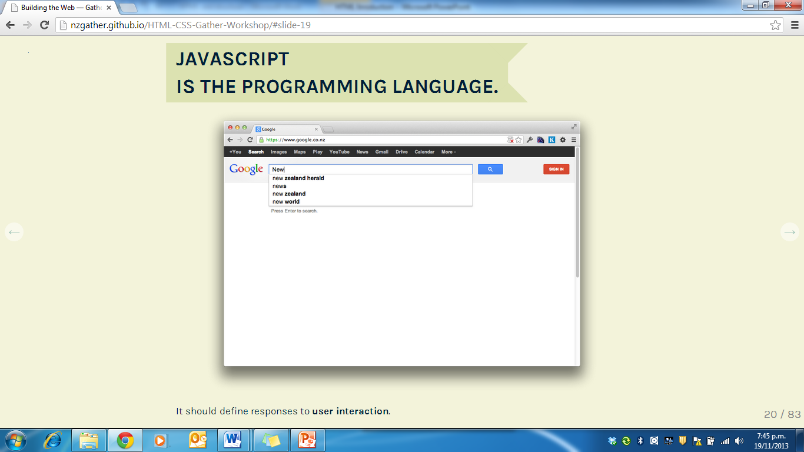

Slide 6
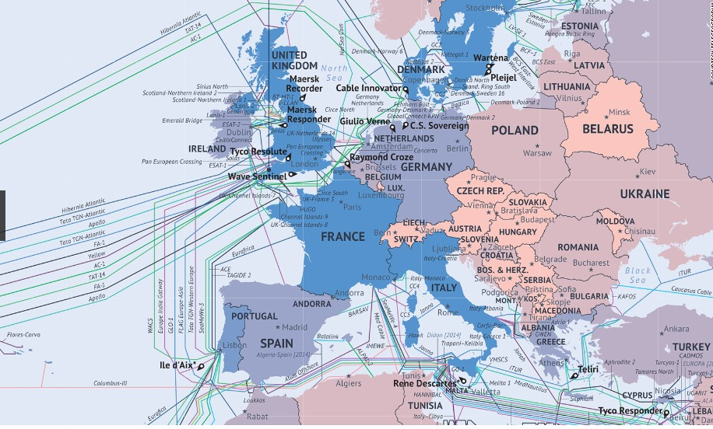
This is what the Internet actually looks like: The undersea cables wiring Europe
http://edition.cnn.com/2014/03/04/tech/gallery/internet-undersea-cables/index.html

Slide 7
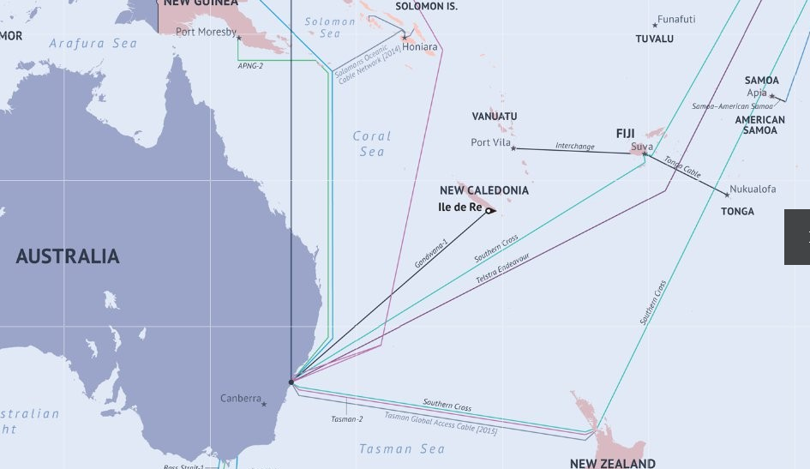
This is what the Internet actually looks like:
The undersea cables wiring our region

Slide 8
The internet cable into NZ
Yes when conditions are right you can actually find the cable and shake it. Scary stuff!
https://dl.dropboxusercontent.com/u/8714203/southern-cross-shakedown.gif

Slide 9
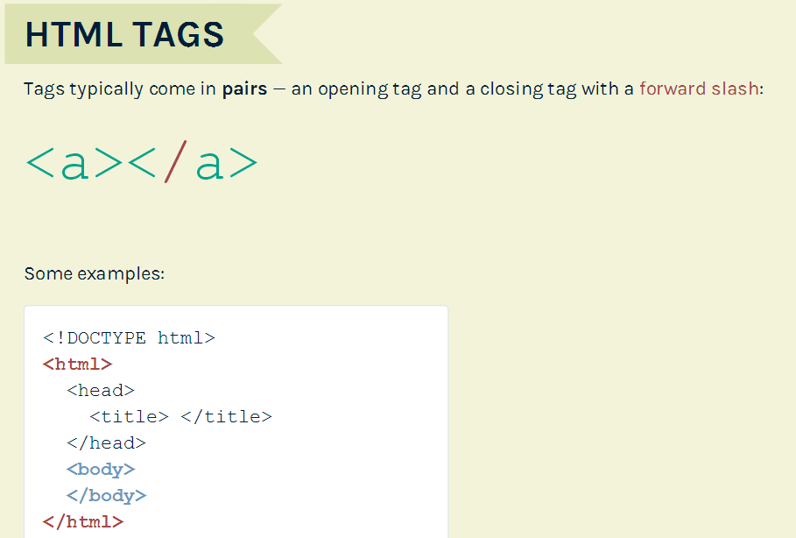
Notes:
Html is a language and as such it has its own set of rules. Break the rules and the code won’t work. Luckily there aren’t too many rules and they are quick to learn. Every HTML document starts with <!DOCTYPE html> Yes capitals are important at times.
The first line just identifies the language version you are using. This is the Doctype for HTML 5. then it is just html which must be opened and closed.
The head contains information about the page rather than information that is shown within the main part of the browser window. The HTML <head> Element has nothing to do with HTML headings but it contains meta data. Meta data are not displayed but like comments eg who wrote the code
The HTML <head> element is placed between the <html> tag and the <body> tag:
Meta data means data about data. HTML meta data is data about the HTML document.
You usually find a <title> element inside the <head> element. The contents of the <title> element are either shown in the top of the browser, above where you usually type in the URL of the page you want to visit, or on the title bar (tab) at the top the browser window.
<body>
Everything inside this element is shown inside the main browser window.

Slide 10
Lets get started

Slide 11
To make a web page you have to code it using html code.
You must follow the html rules or you page will not show on the web as you want it to.
Once you get used to the code it is easy to remember (or you can search on the web for code that might help you).
It is a good idea to run you code frequently as you are making your page so errors can be identified and fixed easily.
Everyone makes errors and you learn from your errors too.
A good website to practice on is
https://www.w3schools.com/html/
Use this link and do the tutorials until you get to the end of paragraphs.

Slide 12
Creating a web page
1 Open Notepad ++
Search for Notepad++
It is important that there are 2 ++
A text editor, eg Notepad++, is used to create a file with the extension.html. This will be our webpage.
This file can be opened in the web browser simply by double clicking on it.

Slide 13
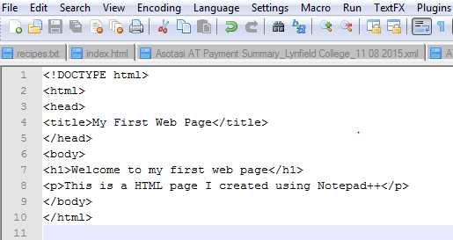
Type the code shown below:

Slide 14
Saving your Notepad++ file
in the way that the web browser can open it.
To run the code (ie see how it looks on the web you must first save it.
Always save your code in a folder (eg html). Go to your Documents folder and 10DTG and check that you have a html folder. If you don’t then make one.
Give the file a name and make sure you add the extension ‘. html’ to the name eg
First_page.html – this will tell the browser to open it using html
Before you click save you must change the save as type to all types which is right up the top of the list (scroll up). This lets the file open on more than one browser.

Slide 15
To see your page on the web
In Notepad++ go to the RUN tab and click on Launch in Chrome.
Questions??????
Open a word doc and type the questions and answers. Save this to your html folder.
In your code you had a title - where does this appear on the browser?
What is the very first line of code you must have on every Notepadd++ file?
Is a <h1> bigger than a <p>?
What is the very last line of code for any web page?
How do you know when a tag is closed?

Slide 16
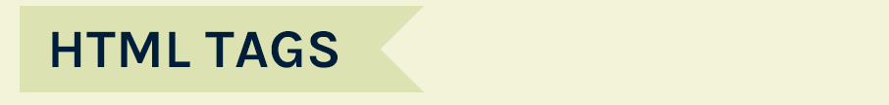
CHARACTER
CHARACTER
<p>
</p>
RIGHT–ANGLE BRACKET
More – than sign
RIGHT–ANGLE BRACKET
More – than sign
LEFT-ANGLE BRACKET
Less than sign
LEFT-ANGLE BRACKET
Less than sign
OPENING TAG
CLOSING TAG
The characters in the brackets indicate the tag’s purpose. For example, in the tags above the p stands for paragraph. The closing tag has a forward slash after the < symbol.

Slide 17
Read the following slides so you get a better understanding of coding using html

Slide 18
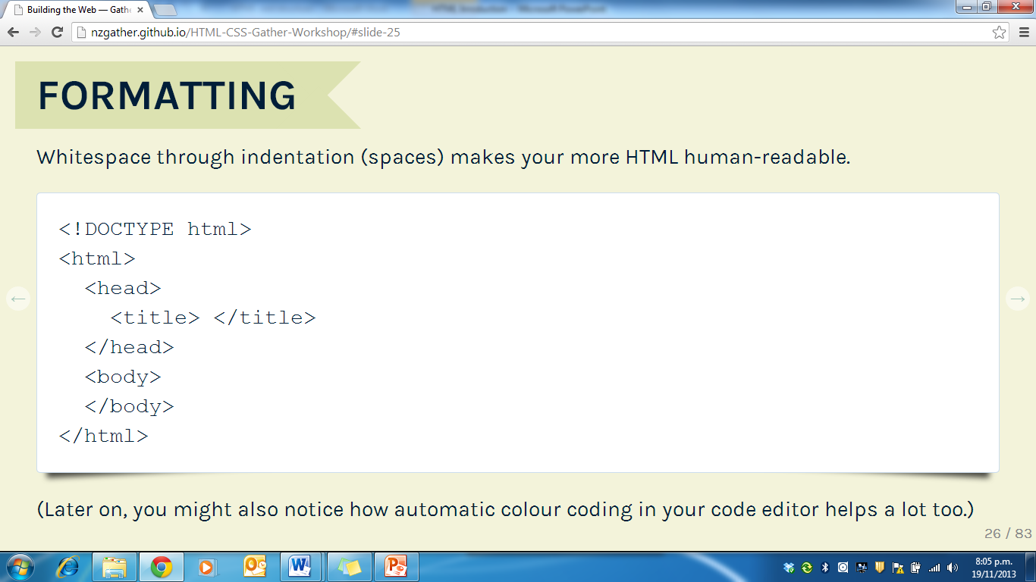

Slide 19
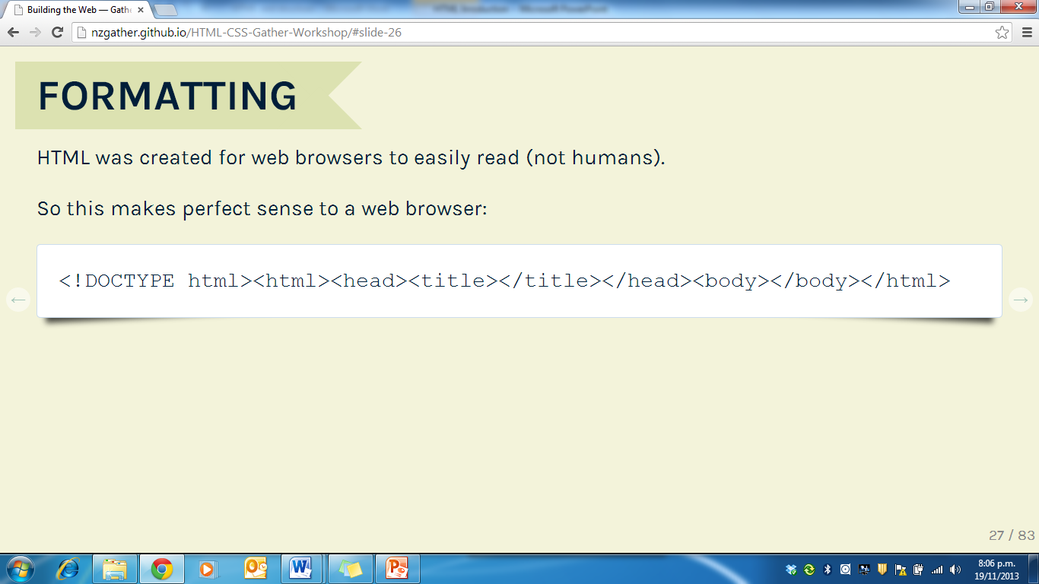

Slide 20
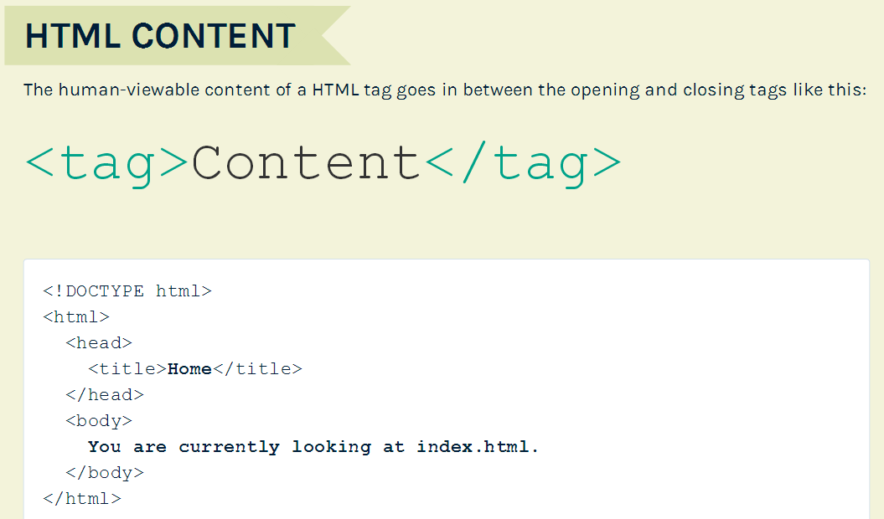

Slide 21
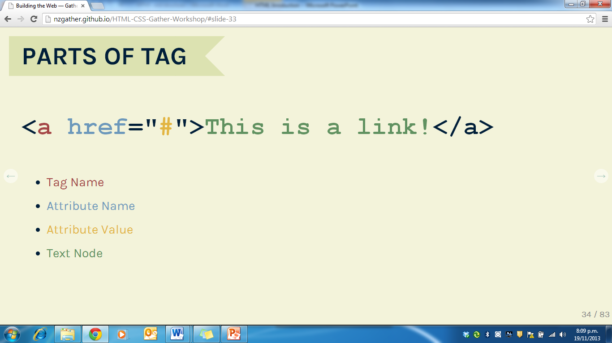

Slide 22
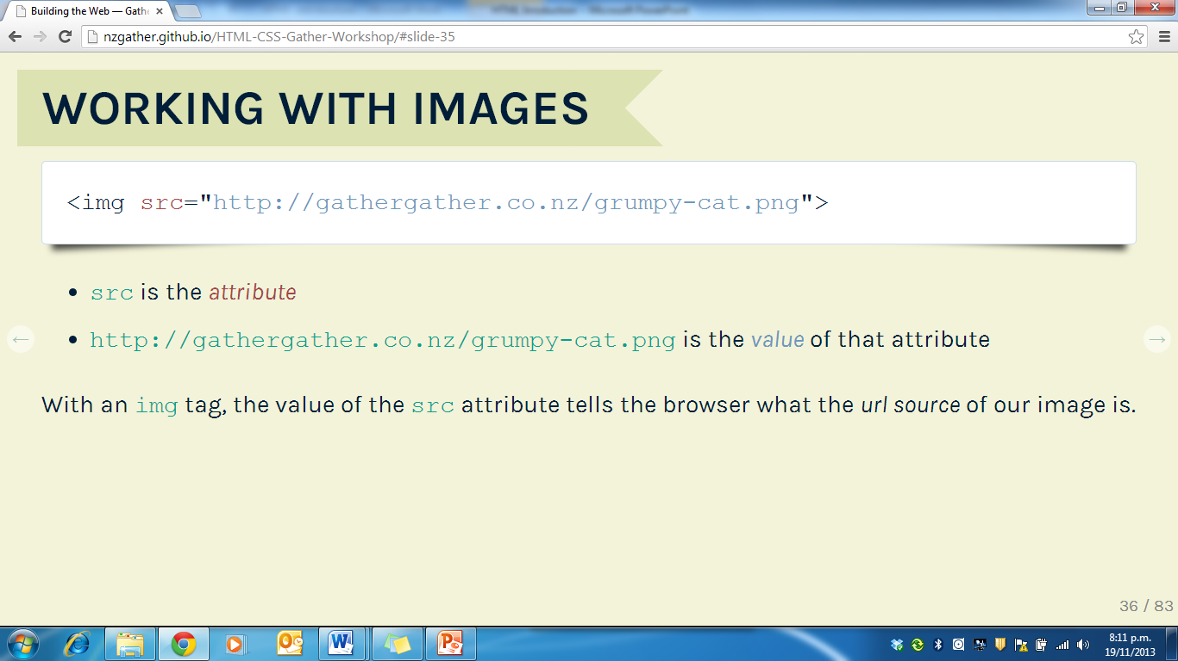

Slide 23
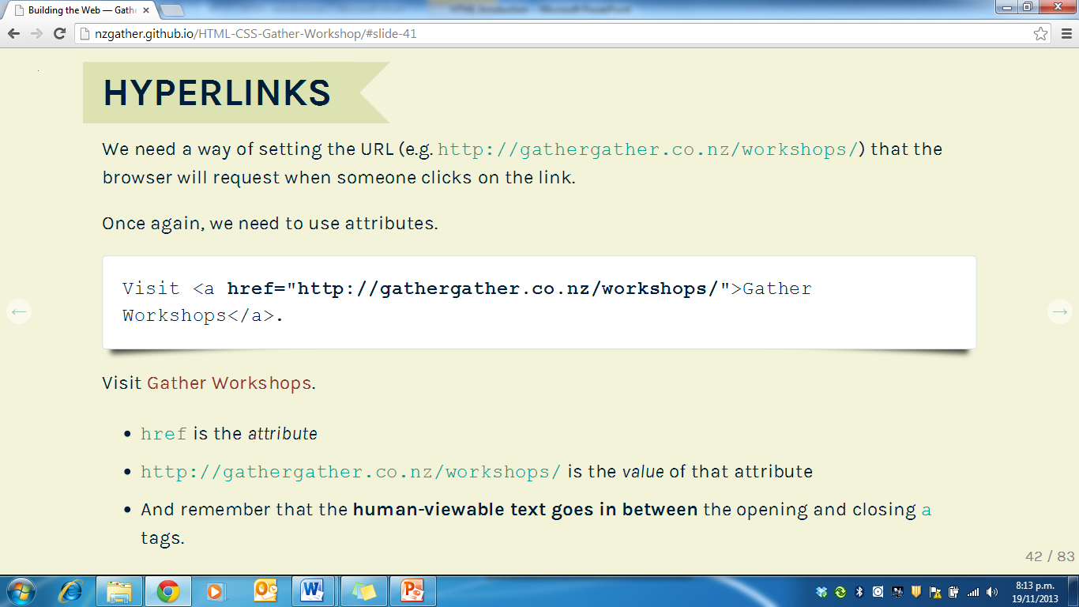

Slide 24
Exercise time
Open the Word file called headings and paragraphs and complete these exercises using Notepad++.
Save each one in your Documents/10DTG/Html (make sure it’s not student read only.)

